Slide 1
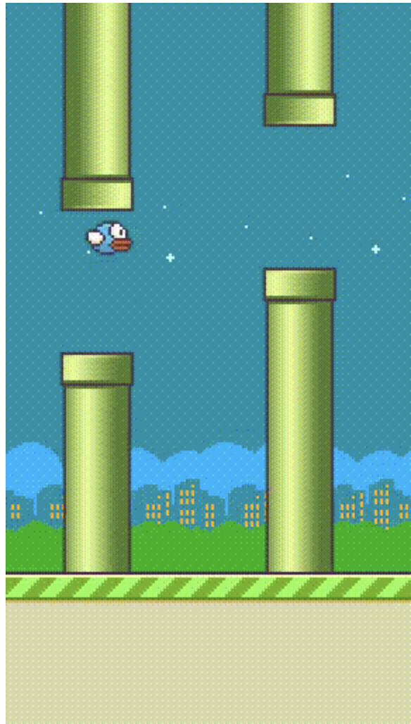
Playing Flappy Bird with Deep Reinforcement Learning
Team members
Pranav Lodha
Subarna Chowdhury Soma
Jeyasri Subramanian

Slide 2
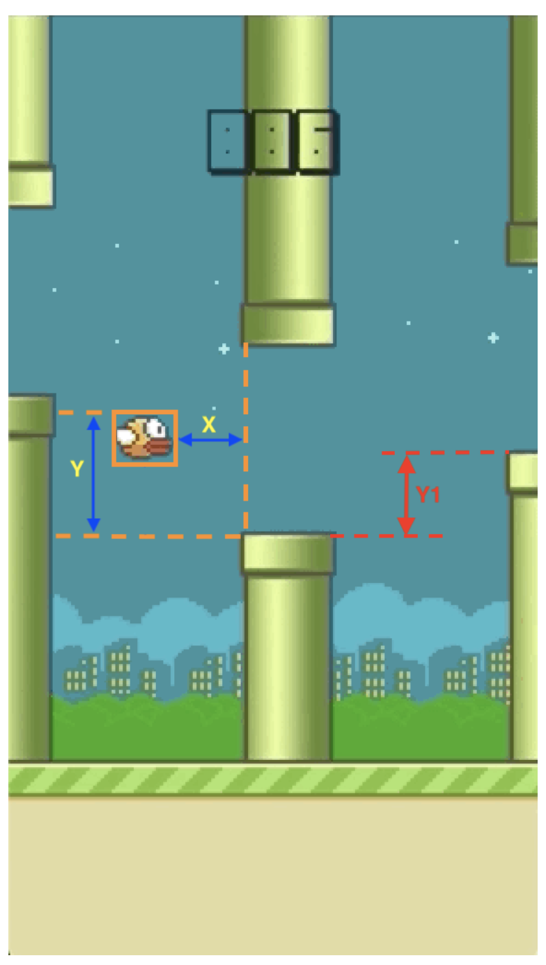
RL Terminology
Agent
Flappy bird
Environment
Uneven Pipe in an infinite trial
288 X 512 X 3 RGB image
Observation
[bird height, bird speed, distance to next pipe(x), height of next pipe(y), distance to second pipe, height of second pipe(y1)]
Reward
+1 for positive reward (escaping death)
Action
Flap or do nothing
Terminal state
If the bird makes contact with the ground, pipes or goes above the top of the screen the game is over.
Notes:
Ref: https://towardsdatascience.com/use-reinforcement-learning-to-train-a-flappy-bird-never-to-die-35b9625aaecc

Slide 3
Problem Statement
Train Flappy bird agent to play continuous using Deep Reinforcement Learning algorithm
Apply Double Dueling Deep Q Networks(D3QN) with Prioritized Experience replay
Fine-tune hyperparameters to improve performance
Compare with other reinforcement algorithm

Slide 4
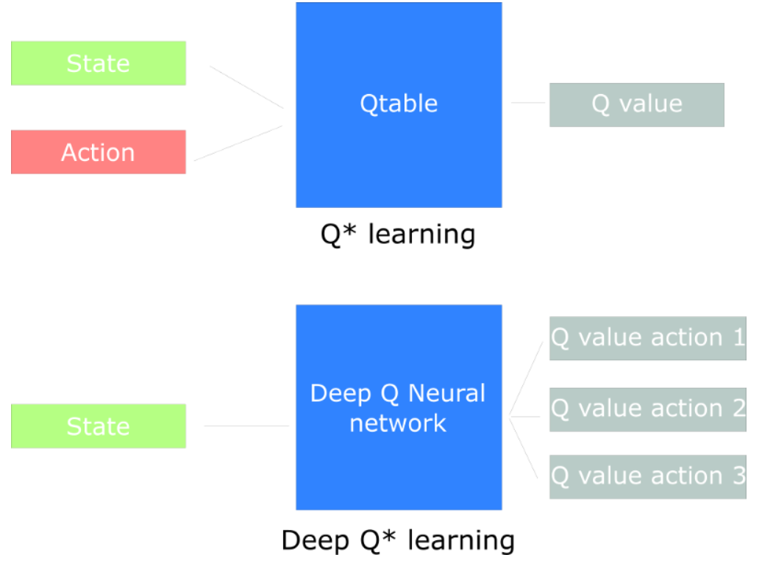
Deep Q-Network (DQN)
Q Learning is off policy learning method in reinforcement learning which is a development over on-policy Temporal Difference control algorithm
Deep Q learning is based on Deep Neural Network
It takes current state in the form of image or say continuous value and approximates Q-values for each action based on that state.
Drawback: The max operator in DQN, uses the same values both to select and to evaluate an action. This makes it more likely to select overestimated values, resulting in over-optimistic value estimates.
Notes:
Q learning formula , explain Q-value

Slide 5
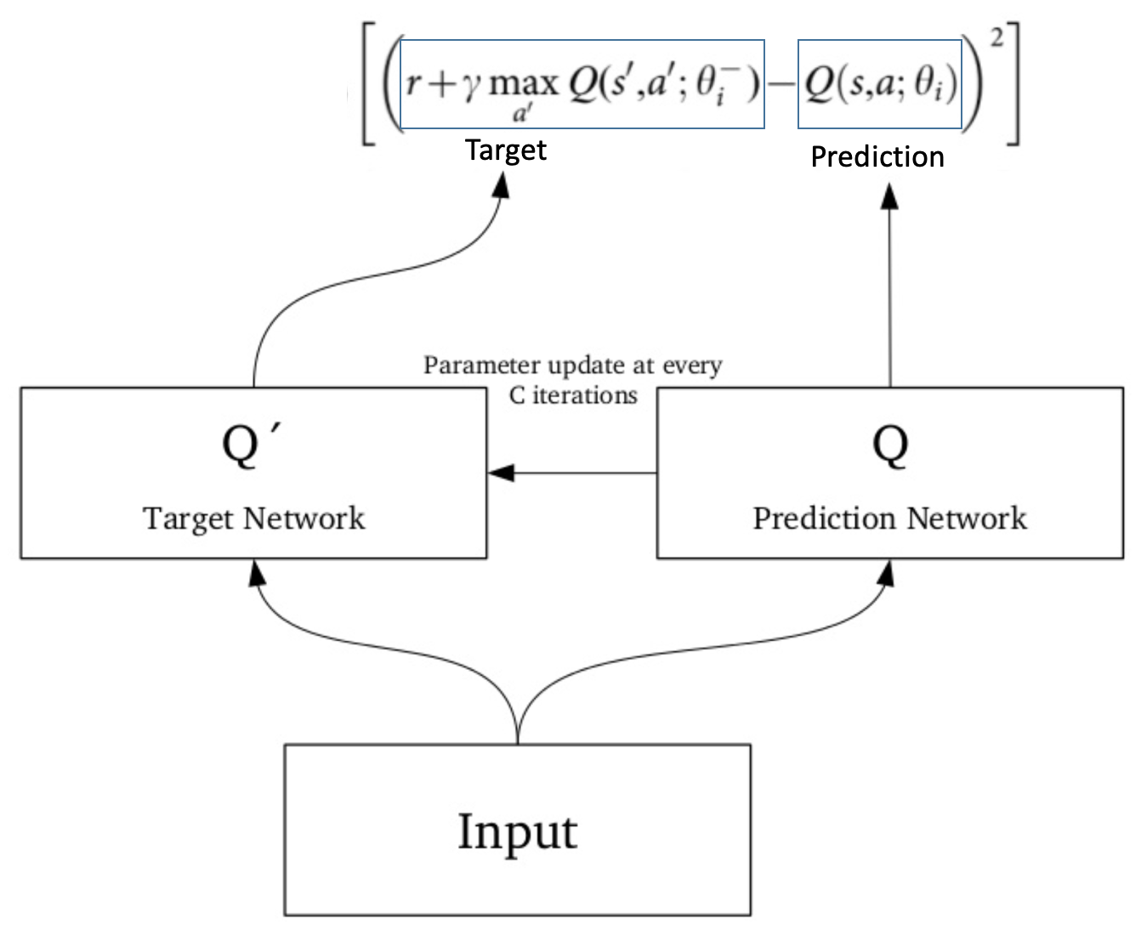
Double DQN
Double DQN uses two networks to decouple the action selection from the target Q value generation.
1. DQN network to select what is the best action to take for the next state (the action with the highest Q value).
2. Target network to calculate the target Q value of taking that action at the next state.
At every Tau step, we copy the parameters from our DQN network to update the target network.
Notes:
Image explaining how the target net is updated everytime after tau time intervals

Slide 6
Our Work
From the prior experiments and study on various Deep RL algorithms, We have applied Dueling Double Deep Q-network (D3QN) with Prioritized experience replay.
Explanations as follows
Dueling DQN
Experience Replay
Prioritized experience replay
D3QN training process
Notes:
Benefits D3QN, drawback of DQN

Slide 7
Dueling DQN
Dueling DQN has two estimator, one estimates the score of current state, another estimates the action score.
Dueling architecture to calculate Q values. Q-values correspond to how good it is to be at that state and taking an action at that state Q(s,a)
Q(s,a) is the sum of:
- V(s) - the value of being at that state
- A(s) - the advantage of taking that action at that state (how much better is to take this action versus all other possible actions at that state).
Q(s,a) = V(s) + A(s,a) -> Advantage function

Slide 8
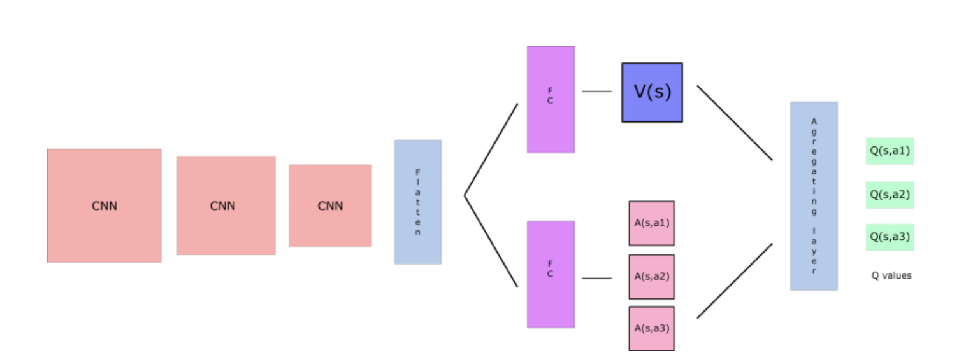
Dueling Deep Q-Network Architecture

Slide 9
Experience Replay
Experience replay is used to handle two things:
Avoid forgetting previous experiences
Reduce correlations between experiences
At each time step, we receive a tuple - state, action, reward, new_state (s,a,r,s')
Replay Buffer stores experience tuples while interacting with the environment, and then we randomly sample a small batch of tuple to feed our neural network

Slide 10
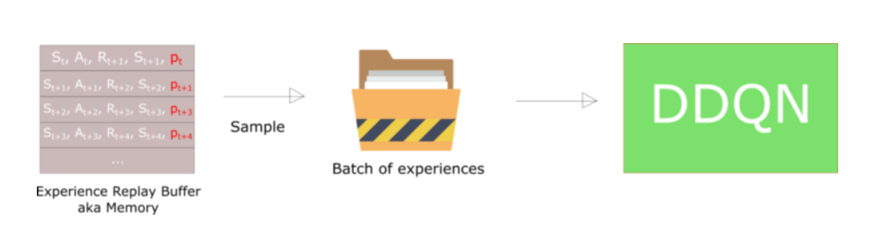
Prioritized Experience Replay
Some experiences may be more important than others for our training, but might occur less frequently (entropy)
We compute the priority using the frequency of occurance
Priority is stored with each experience in replay buffer.
To avoid bias and overfitting, we use random minibatch of replay buffer to compute the loss

Slide 11
Training steps in Double Dueling Deep Q Network (D3QN)
Source and Target networks are Dueling DQN networks – 3 CONV2D networks with Relu activation
The training method is used to train our q network for q values.
Update target network every time after q network is trained for tau times.
The Q values are predicted for currents state and next states by q network and target network respectively.
From the frequency of occurance of state value, the prioritized experience replay computes the priority and stores with (s,a,r,s')
Then we sample batch of experiences. These sample batches are tuple array of states, actions, rewards, next states, done and priority variable.(s,a,r,s',p)
Compute Temporal Difference Error for loss computation
Then we calculate the batch index and perform the update operation. Note that this update uses a double DQN update i.e instead of a max of q value of next state, we put q value predicted by the target network for action that has maximum q value according to q network in the next state.
The update equation is multiplied by done variables because for terminal state q value is always zero.
Then we train the model, update epsilon, and increment train step.
Notes:
Reduce the texts

Slide 12
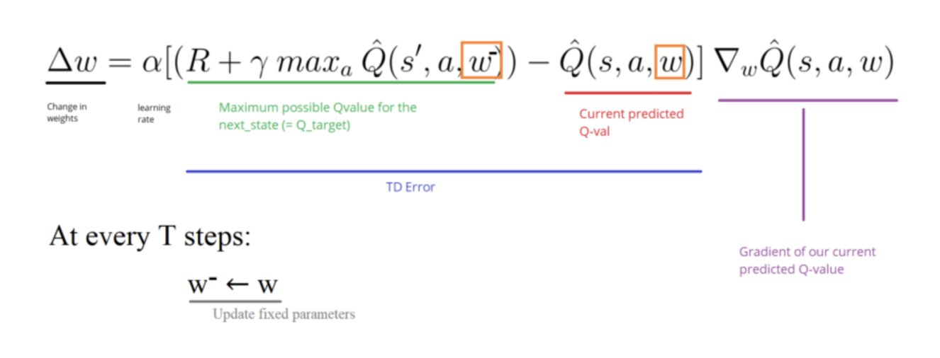
Temporal Difference Error computation (Loss function) and backpropagation

Slide 13
Explaining hyperparameters
SKIP FRAME: Agent takes action on every k- frame instead of every frame, the last action is repeated on skipped frames.
ACTIONS: Flappy bird has two actions: 1) Do Nothing 2) Flap.
GAMMA: Gamma is the discount factor. It quantifies how much importance we give for future rewards. Gamma varies from 0.95 to 0.99.
ALPHA: Alpha is the learning rate.
EPSILON: Used for Exploration and Exploitation. The agent takes random actions for probability ε and greedy action for probability (1-ε).
SYNC_TARGET_FRAME (Tau): We update the target network with the DQNetwork in every tau step.
EXPERIENCE_BUFFER_SIZE: Size of the experience buffer.
MEAN_GOAL_REWARD: The max reward an agent gets for all good action(positive reward) is +1. The mean goal reward is a programmer's choice to train the agent any value greater than or equal to +1.
BATCH_SIZE : Neural network training batch size.
Notes:
EPSILON: Google DeepMind used a decaying ε-greedy action selection. Where ε decays over time from 1 to 0.1 — in the beginning, the system makes completely random moves to explore the state space maximally, and then it settles down to a fixed exploration rate
gamma is the discount factor. It quantifies how much importance we give for future rewards. It’s also handy to approximate the noise in future rewards. Gamma varies from 0 to 1. If Gamma is closer to zero, the agent will tend to consider only immediate rewards. If Gamma is closer to one, the agent will consider future rewards with greater weight, willing to delay the reward
State dim? k frames
I use the last 4 frame as the input. This should help the agent to know the change of environment.

Slide 14
Experiment: Hyperparameter Tuning
No | Hyperparameter | Value | Result | Convergence | Attempts Required in 3mins
1 | SYNC_TARGET_FRAMES | 15 | GAME : 6680 | EPSILON : 0.0058 | MEAN REWARD : 1.0 | YES | 2
2 | SYNC_TARGET_FRAMES | 60 | GAME : 23000 | EPSILON : 0.0010 | MEAN REWARD : 0.98 | NO
3 | SYNC_TARGET_FRAMES | 90 | GAME : 6433 | EPSILON : 0.0010 | MEAN REWARD : 1.0 | YES | 10
4 | GAMMA | 0.95 | GAME : 5070 | EPSILON : 0.0010 | MEAN REWARD : 1.0 | NO
5 | GAMMA | 0.98 | GAME : 5000 | EPSILON : 0.0010 | MEAN REWARD : 1.0 | YES | 2
6 | EXPERIENCE_BUFFER_SIZE | 500 | GAME : 16790 | EPSILON : 0.0010 | MEAN REWARD : 1.0 | YES | 8
7 | EXPERIENCE_BUFFER_SIZE | 8000 | GAME : 8210 | EPSILON : 0.0010 | MEAN REWARD : 1.0 | YES | 3

Slide 15
Experiment: Hyperparameter Tuning
No | Hyperparameter | Value | Result | Convergence | Attempts Required in 3mins
8 | LEARNING_RATE | 1e-6 | GAME : 25000 | EPSILON : 0.0010 | MEAN REWARD : .69 | NO
9 | LEARNING_RATE | 1e-2 | GAME : 8735 | EPSILON : 0.0010 | MEAN REWARD : -1.0 | NO
10 | SKIP_FRAME | 5 | GAME : 15015 | EPSILON : 0.0010 | MEAN REWARD : 0.4 | NO
11 | SKIP_FRAME | 1 | GAME:3375|EPSILON: 0.0010| MEAN REWARD : 0.98 | YES | 4
12 | BATCH_SIZE | 16 | GAME : 4030 | EPSILON : 0.0010 | MEAN REWARD : 1.0 | YES | 2
13 | BATCH_SIZE | 64 | GAME : 4030 | EPSILON : 0.0010 | MEAN REWARD : 1.0 | YES | 2

Slide 16
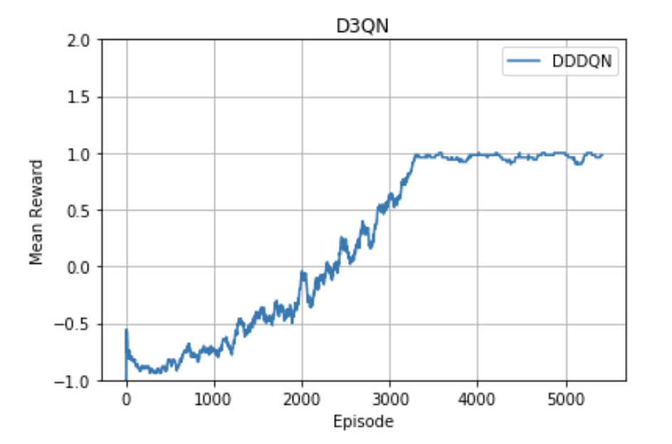
Best Performing Model
Hyperparameter | Value | Result
EXPERIENCE_BUFFER_SIZE | 2000 | GAME : 5225 | EPSILON : 0.0010 | MEAN REWARD : 1.0
STATE_DIM | 4
ACTIONS | [0,1]
GAMMA | 0.99
EPSILON_DECAY_FRAMES | (10**4)/3
MEAN_GOAL_REWARD | 1
BATCH_SIZE | 32
SYNC_TARGET_FRAMES | 30
LEARNING_RATE | 1e-4
SKIP_FRAME | 2
Notes:
Explain the graph like what Vs What

Slide 17
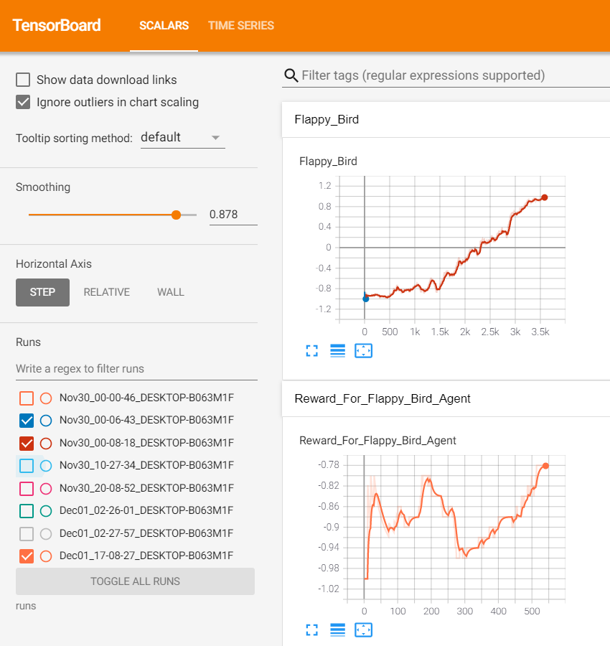
TensorBoard

Slide 18
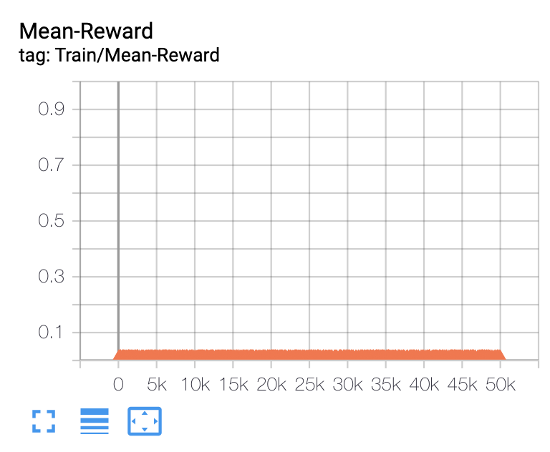
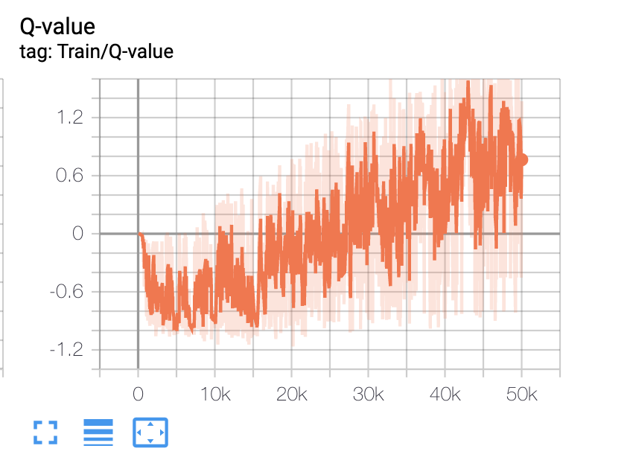
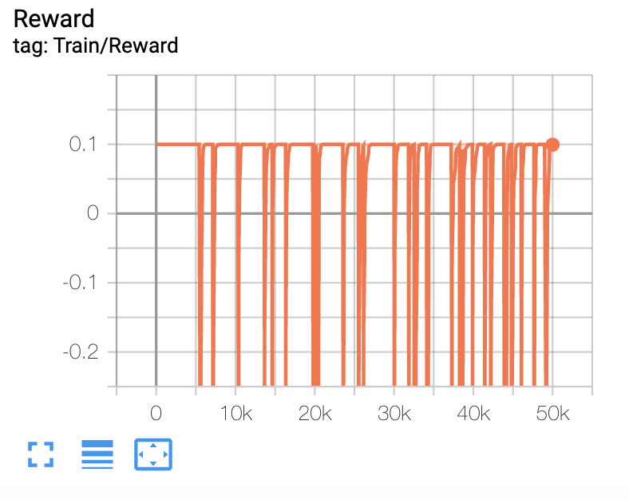
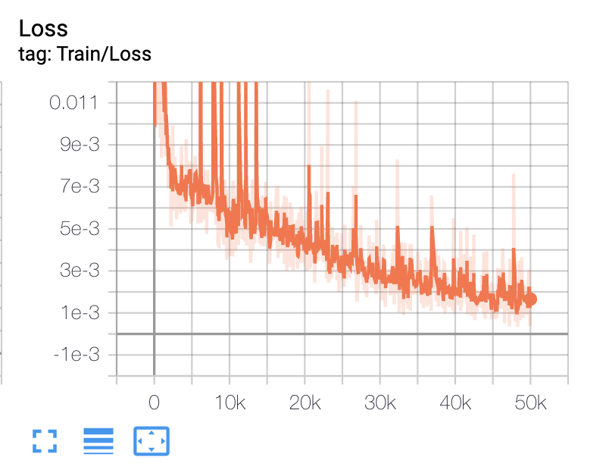
Comparison study with DQN
We tried experimenting flappy bird agent with Deep Q Network. After training for 50K iterations, the network didn't converge.

Slide 19
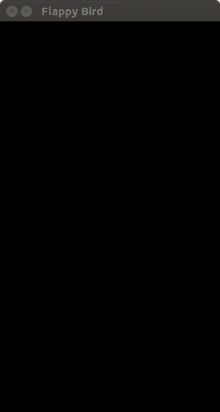

Demo

Slide 20
Key learnings and challenges
Key Learnings
We explored some Deep Q Network – DQN, DDPG
We understood Flappy bird agent's action and state space
Training an end-to-end deep reinforcement learning algorithm
Understanding and Fine-tuning hyperparameter to get the best model
Challenges
Flappy bird agent is not present in open gym environment, hence we used pygame, gym_ple or custom python code from opensource to setup the agent for programming.
Training time with GPU machine is also high, hence experiments took much time to complete
Very few Deep RL algorithms were applied to train this agent

Slide 21
Project Management
Github: https://github.com/s-c-soma/RL_Project_FlappyBird_D3QN
Trello: https://trello.com/b/8CrK9MHe/rl-the-mean-squares

Slide 22
Team members Contribution
Pranav Lodha
Literature study on various DQN
Understanding prioritized experience replay
Inference pipeline with best model
Subarna Chowdhury Soma
Understanding D3QN
Exploring various research works in D3QN
Experiments with hyperparameters
Jeyasri Subramanian
Exploring various DQN architecture and design architecture
D3QN environment setup
Comparison study with DQN
Team
Report writing
Presentation
Demo
Each team member shared the knowledge with other team members about literature study and architecture

Slide 23
References
https://www.fromkk.com/posts/using-ddqn-to-play-flappy-bird/
https://towardsdatascience.com/use-reinforcement-learning-to-train-a-flappy-bird-never-to-die-35b9625aaecc
https://towardsdatascience.com/practical-reinforcement-learning-02-getting-started-with-q-learning-582f63e4acd9
http://cs229.stanford.edu/proj2015/362_report.pdf
https://www.freecodecamp.org/news/an-introduction-to-deep-q-learning-lets-play-doom-54d02d8017d8/
https://www.freecodecamp.org/news/improvements-in-deep-q-learning-dueling-double-dqn-prioritized-experience-replay-and-fixed-58b130cc5682/
https://markelsanz14.medium.com/introduction-to-reinforcement-learning-part-4-double-dqn-and-dueling-dqn-b349c9a61ea1
https://arxiv.org/pdf/1511.06581.pdf
https://arxiv.org/abs/1509.06461

Slide 24

Thank you

Slide 25

Questions

